Slide 1

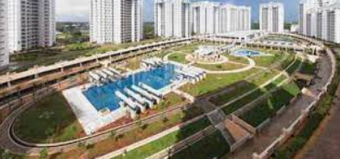
Applied Machine Learning

Slide 2

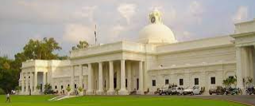
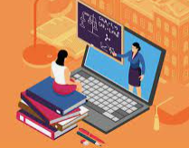

Introduction
M
Manish Agarwal : Sr Management, technical operations, operationalizing new technologies along with the usual GRIND ☺
Jaya Singh: Technology Architect, researcher in Machine Learning
We both have completed 1 year ML program form IIT-R
Taught ML concepts online and internally within our organizations
Working on projects at work
https://www.linkedin.com/in/manishkagarwal/

Slide 3

Agenda
J
Applications & Future of machine learning
Machine Learning in networking
Is machine learning magic ?
Types of machine learning
Build a simple regression model
Build a simple CNN image detection model
Challenges for Machine Learning
Learning Roadmap for machine learning
What you should know to learn machine learning
Free resources ( you tube playlist, Books, GitHub profiles, Podcast )
Brain Twister (Interesting quiz)
References
Hands on
Brain Twister/s

Slide 4
Dilemma ?
M
This is an introductory session; it is difficult to gauge the right breadth and depth of the audience.
Ask questions and we will try to react real-time( slow or fast)
Assumption:
Many of you might be starting your AI/ML journey and this could be one of the early steps towards the path

Slide 5
What else do you get ?
M
Quiz link at the end
Access to the slides and notebooks, use them for your office presentations, among friends and groups
Rs 500 amazon voucher
Connect with like minded people on the WhatsApp group
Rs 500 amazon voucher

Slide 6
Let's start with some motivation (while others join)
M
https://www.youtube.com/watch?v=d_ahOQIvPLk

Slide 7

Where is the industry ?
M
ML
Deep Learning
GenAI/LLMs
NLP

Slide 8
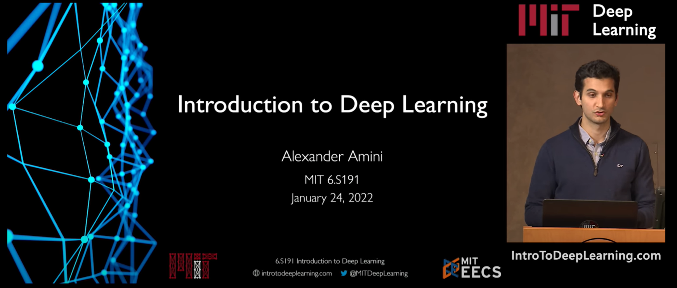
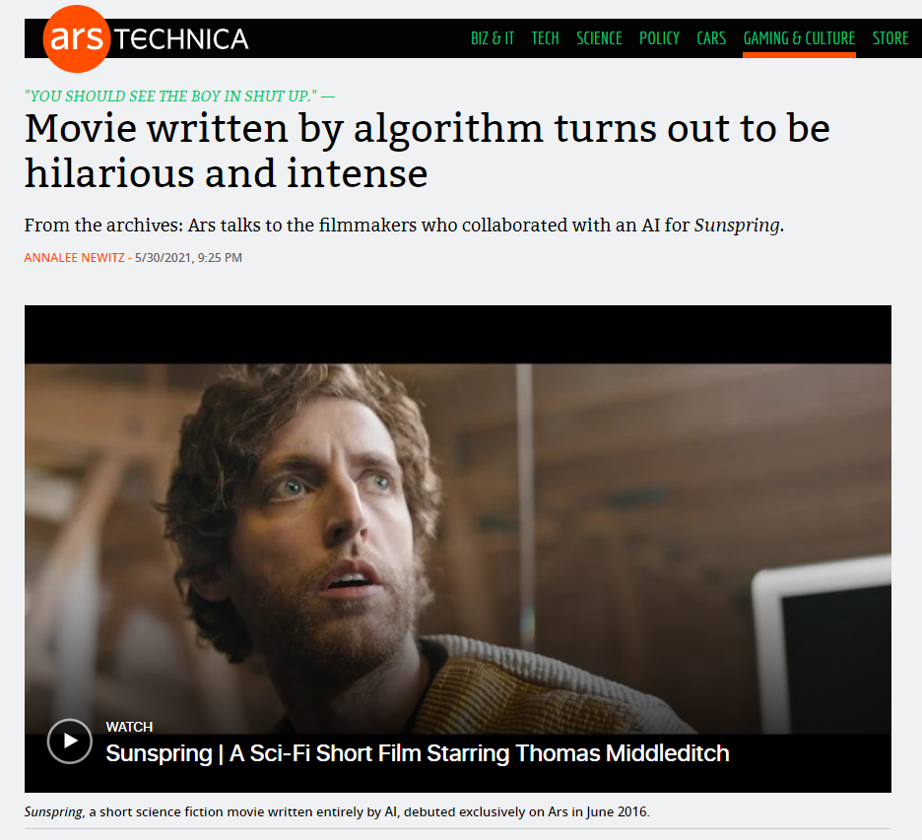
Application of Machine Learning
M
Let's see some powerful examples:
VideoLink
1:39 – 2:22
Movie script written by AI
VideoLink
Science fiction, LSTM NN
Notes:
Start @ 1:36 , Stop 2: 27
0:19

Slide 9
If you want to Impress someone !
M
https://teachablemachine.withgoogle.com/v1/

Slide 10
Everyone is saying AI will take the jobs ?
Why is it not easy, anyone ?
Speak your mind
Notes:
We need digitization, formalization and automation driven operations

Slide 11
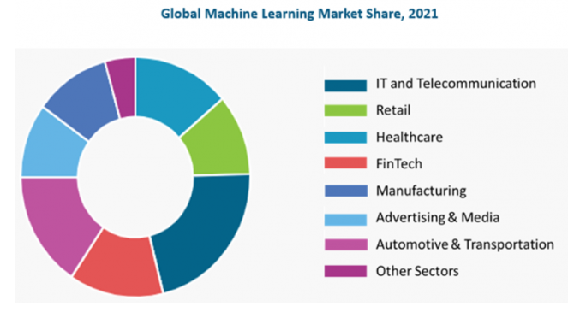
Industries disrupted by Machine Learning
HealthCare:
Disease Prediction : Based on patient's demographics, health records.
Drug Discovery: Speeds up drug testing time.
Medical Image diagnosis: Deep learning and computer vision
FinTech:
Fraud Detection
Loan automation

Slide 12
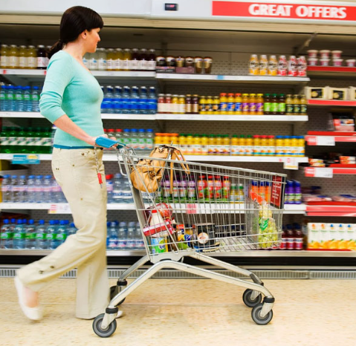
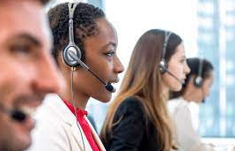
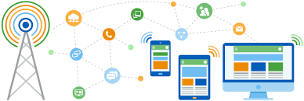
Industries disrupted by Machine Learning
Retail:
Customer Segmentation
Churn Prediction
Customer Service:
Chatbots
IT and Telecom:
Predictive maintenance
Demand prediction
Churn prediction

Slide 13
Application in Networking - Manish
Intrusion detection
Can adopt to evolving patterns
Co-relate network phenomenon between latency, paths, routers, events ( enabled by In-band Telemetry)
Alarm co-relation (technology agnostic)
Predict traffic trends
Based on tweets from certain location, news feed , event etc.
Identify and co-relate condition which may lead to congestion in network (e.g. traffic drops in bad weather ? )

Slide 14
Applications in Banking - Jaya
Mainly used for Fraud detection
Regulatory compliance
Evaluating risk:
Market risk
Customer risk

Slide 15
Can you identify other applications for machine learning in your domain?
M
OR where you intend to apply Machine learning ?
Notes:
Email spam detection
Loan approvals
Self driving cars

Slide 16
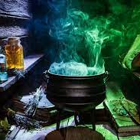
Powerful Insight
M
Variation – Variation – Variation
No variation – Poor prediction
And
A lots & lots of compute
Is it magic?

Slide 17
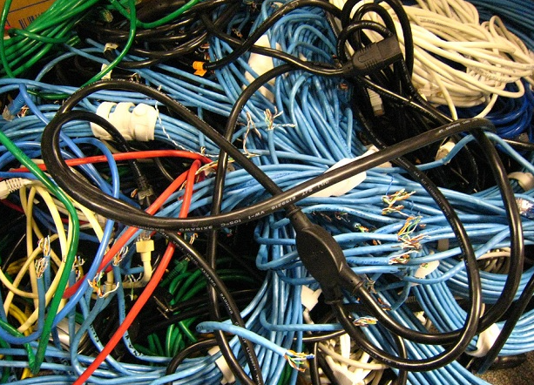
Why ?
M
Y
Y
5
X
X
10
15
25
10
15
25

Slide 18
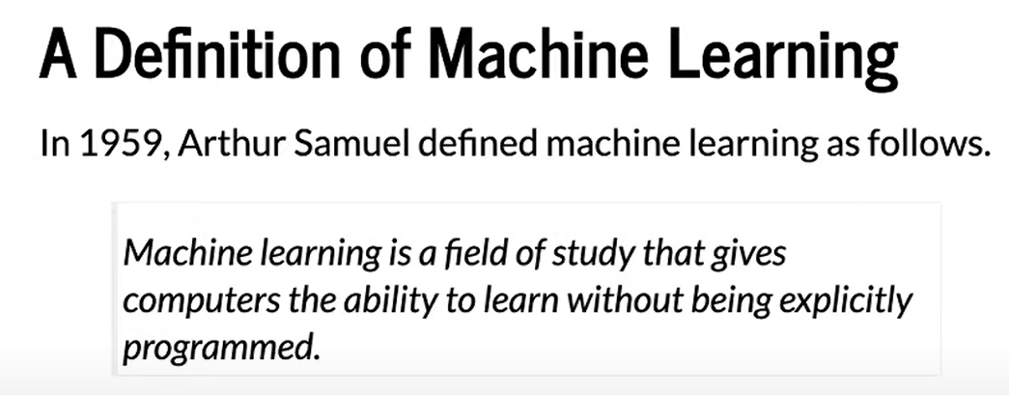
Definition
Pass
M
A computer program is said to learn from experience E with respect to some class of tasks T and performance measure P, if its performance at tasks in T, as measured by P, improves with experience E.

Slide 19
Machine Learning types : Based on amount of supervision needed
J
Regression
Supervised
Classification
Clustering
Types of ML
Dimensionality reduction
Unsupervised
Anomaly detection
Semi supervised
Association rule learning
Reinforcement

Slide 20
Supervised Learning
Regression
If you have input and output and the task is to find the relation between input and output.
Simple example:
Supervised
Classification
Clustering
IQ | CGPA | Placement
87 | 7.1 | Y
111 | 8.9 | Y
75 | 6.3 | N
Types of ML
Dimensionality reduction
Unsupervised
Anamoly detection
Semi supervised
Association rule learning
Reinforcement

Slide 21
Supervised - Classification Vs Regression
IQ | CGPA | Placement
87 | 7.1 | Y
111 | 8.9 | Y
75 | 6.3 | N
Classification
Yes/No
Supervised o/p
Regression
Continuous type
IQ | CGPA | Package
87 | 7.1 | 10L
111 | 8.9 | 15L
75 | 6.3 | 17.5L

Slide 22
Unsupervised
Regression
Generally, the output is one of these four things:
Clustering
Dimensionality reduction
Anomaly detection
Association rule learning
Supervised
Classification
Clustering
Types of ML
Dimensionality reduction
Unsupervised
Anamoly detection
Semi supervised
Association rule learning
Reinforcement

Slide 23
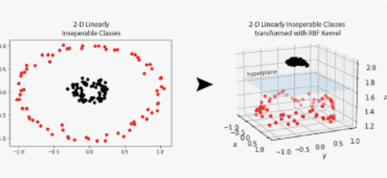
Unsupervised learning - Clustering
J
Clustering
Ex1:
Plot the student data on a coordinate system
We can now label the students based on clusters
Other examples:
Customer segmentation
Student data
Notes:
Clustering can take high dimensional data and generate cluster.
Customer segmentation and later come with business plans to retain or on

Slide 24
Unsupervised learning – Dimensionality reduction
Pass
J
T-SNE with MNIST
100s or 1000s of input column
Model performance will be slow
Highly dimensionality data cannot be visualized ?
Eg:
MNIST data set is ~ 784 dimension( 28 X 28)
T-SNE helps to reduce the dimension to 3 dimension which can now be visualized
Youtube:
https://www.youtube.com/watch?v=-bijVUtFCm4
Implementation:
https://github.com/deveshSingh06/t-SNE/blob/master/t-SNE%20Implementation.ipynb
Notes:
Clustering can take high dimensional data and generate cluster.
Customer segmentation and later come with business plans to retain or on

Slide 25
Unsupervised learning – Anomaly detection
J
Find anomalous pattern
Loan approval
Manufacturing
Software logs
User logins and log out
Security logs etc.
heat
vibration

Slide 26
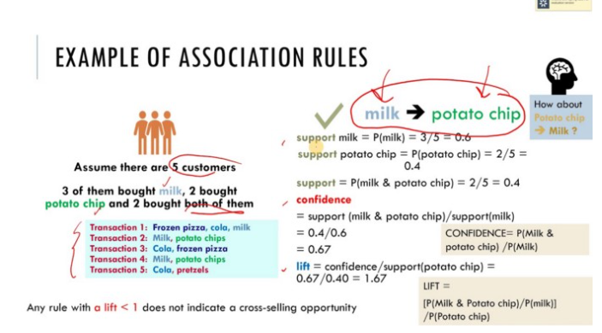
Unsupervised learning – Association rule-based learning
J
Eg: Amazon recommendation of related products
Looks at the bills and identify patterns and may be place these items together or provide discounts together
Interesting case study:
“customers who go to the store to buy diapers will also tend to buy beer at the same time”
https://medium.com/@kirk.borne/association-rule-mining-not-your-typical-ml-algorithm-97acda6b86c2#:~:text=If%20there%20was%20no%20association,diaper%20purchasers%20also%20buy%20beer
Notes:
Only machine learning can find such patterns

Slide 27
ML types : Based on amount of supervision needed
J
Regression
When the cost of labelling the data is high.
The idea is to generate partially labelled data and use it to label other non labelled data.
Eg: Facebook if you label one image al other images with your pics will get labelled.
Google Photos cluster photos (without knowing the label) and once you label one image all other pictures are labelled.
Supervised
Classification
Clustering
Types of ML
Dimensionality reduction
Unsupervised
Anamoly detection
Semi supervised
Association rule learning
Reinforcement

Slide 28
Side Topic: Data Types
J
Gender
Nominal
Nation
Categorical
First, second
Ordinal
Data types
High, medium, low
Height
Numerical
Weight
Cost

Slide 29
Reinforcement Learning
J
Regression
No labelled data
Learn and improve
Maximize the rewards
Robots
Chess game
Self driving cars
Deep mind – Alpha Go
Supervised
Classification
Clustering
Types of ML
Dimensionality reduction
Unsupervised
Anamoly detection
Semi supervised
Association rule learning
Reinforcement

Slide 30
Brain-twister
J
How much will it rain today ?
Classification ? Regression?
Will it rain today ?
Classification ? Regression ?
If a dog is present in an image or not ?
Classification ? Regression?
How many dogs in an image
Classification ? Regression?
? Any other quick question ?
Notes:
If It is a number – Regression, if it is a category – Classification
Classification can have more than 2 classes ( like # detection)

Slide 31
Build a Simple Regression model
J
Pre-requisite:
Google Collab
Or Jupyter notebook
Create a model which can predict Salary based on years of experience.
Supervised machine learning ?
Is it Classification ? Regression ?
Dataset:
Experience and Salary provided for ~30 professionals

Slide 32
Building block for a Model
Ingest Data
Clean data
EDA
Feature engineering
Preprocessing
Build Model
Working with Data
Building and Hosting a model

Slide 33
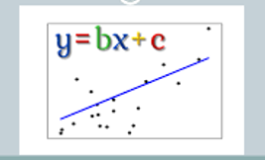
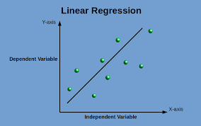
Building Simple Regression model
What is the difference between a “Algorithm” and a “Model”
ML_Training_simple_linear_regression.ipynb
https://github.com/share2learnwidmanish/MachineLearning_Infinera
Salary_Data.csv

Slide 34

Beware!
M

Slide 35
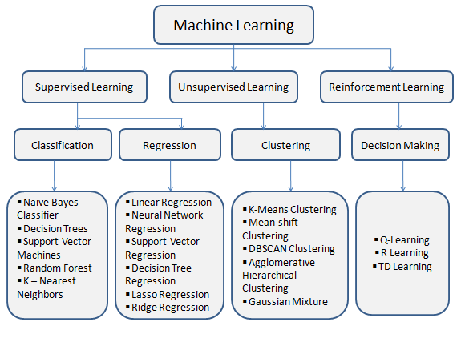
Different Models(Reference only)

Slide 36
CNN – enabling Computer Vision
Computer Vision had and will transform many applications:
Logistics
Self driving cars
Facebook
Threat control
How does a computer recognize an Image ?

Slide 37
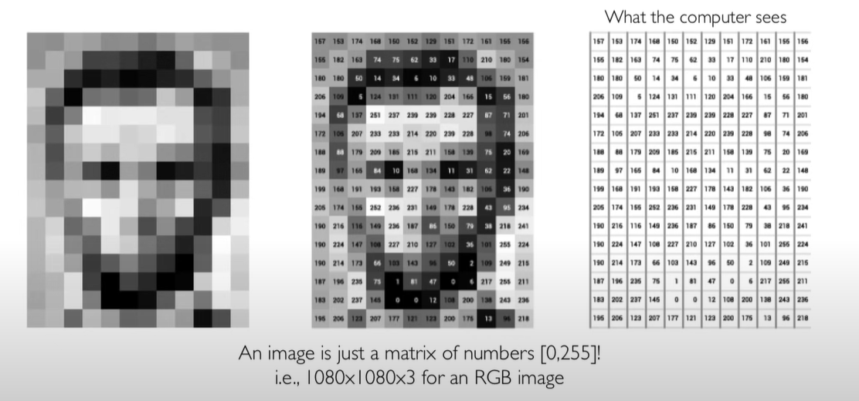
Image representation
RGB

Slide 38
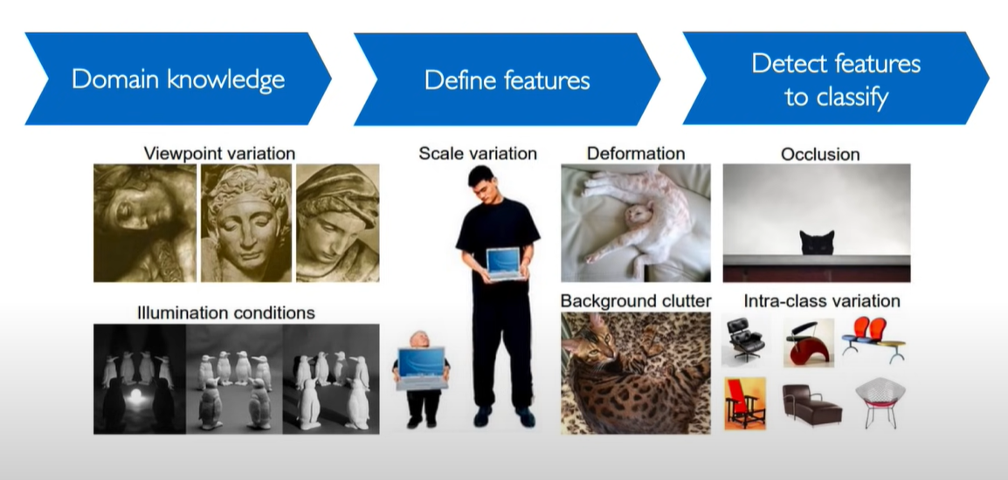
Challenges for Image detection

Slide 39
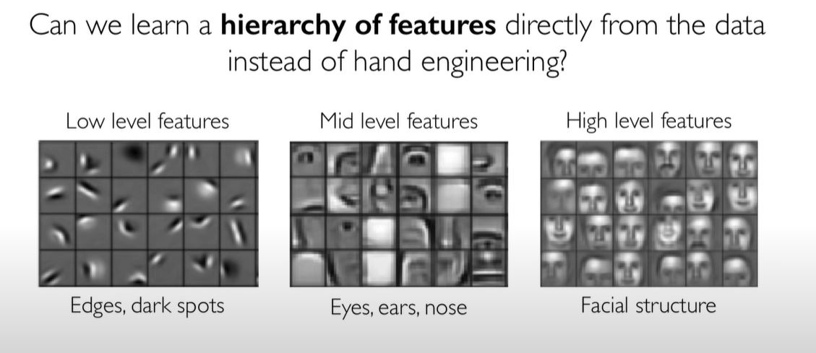
Approach

Slide 40
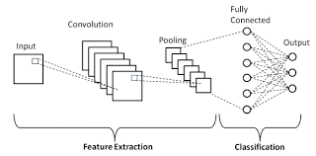
Build an Image detection model
CNN layers (can also be referred as computer vision)

Slide 41
Build a CNN model
https://github.com/share2learnwidmanish/MachineLearning_Infinera/tree/main/CNN_Image_detection
C:\Users\maagarwal\OneDrive - Infinera\IIT-Roorkee-PGP\Training\Master_Class\Build_CNN_Model\Section 40 - Convolutional Neural Networks (CNN)

Slide 42
Challenges in Machine Learning
Complexities with Data(Data Drift):
Amount of data for training : often times, there aren't enough data available for building models.
Quality of data: Often while building models, amount of data is not sufficient , has lots of noise, is not clean, has missing values etc. This part consumes about 80% of time.
Model Deployment :
Given the tech stack which a company uses, deploying models built in python/pandas could be challenge too.
Managing and stabilizing Models :
Understanding results, running health checks, monitoring model performance, watching out for data anomalies, and retraining the model
Configuring Environments:
While building models, first and foremost step is to configure suitable environment which takes up another effort of data scientists.
Over the period of time, libraries / environment changes which leads to upgrading all relevant libraries for a model to run successfully.

Slide 43
(free)Learning Resources
Topic | Link
Statistics Fundamental(StatQuest) | Statquest-Youtube
Essentials of Linear Algebra(3Blue1Brown) | 3Blue1Brown-Youtube
Basics of Machine Learning(StatQuest Youtube playlist) | StatQuest-Youtube-ML
Machine lecture by Prof. Kilian Weinberger(University of Cornell) | University of Cornell - YouTube
Introduction to Deep Learning MIT | MIT DeepLearning - YuoTube
ML Lectures Kimia labs | Kimia Labs - Youtube

Slide 44
Quiz link:
https://docs.google.com/forms/d/1XwDodYzI95QrF4f9AFq6RZlyfPlzm5FVTQGRNfGvIW0/edit

Slide 45
Foundational models (GenAI / LLM)
Generic tasks
Semi –supervised learning
Billions of parameters
Trained on almost entire internet

Slide 46
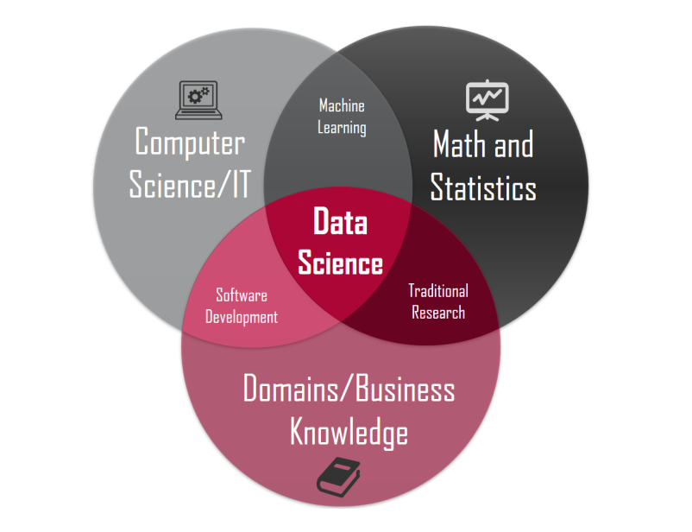
(self)Learning RoadMap
If you want to learn ML or DS concepts on your own, then below the things to focus on:
Math's and Stats
Programming with Python
Database and SQL
Data Analysis and simple Visualization
Supervised Machine Learning
Unsupervised Machine Learning
Advanced ML Concepts
TensorFlow
Deep Learning
NLP
Productionizing
Note : Practice as much as you can . Kaggle is one of the best source to start from.

Slide 47
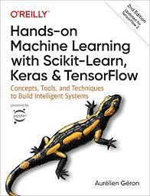
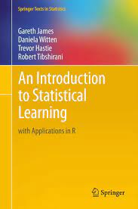
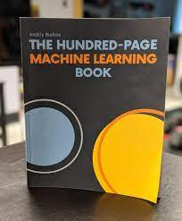
Books

Slide 48
Learning anything is easy:
You can buy a book; change will manifest when you “read” it as well ☺

Slide 49
Backup
https://www.linkedin.com/in/manishkagarwal/

Slide 50
My thoughts ?
How much time will it take for me to learn ML – Typically 6 – 12 month
How much time/week – Consistently 8-10 hrs.
How much Math should I know: Not much, if you refresh basics on linear algebra, you should be good building models.
How much stats should I know : Not much, refresh your basics. Many python and ML libraries abstracts statistical methods

Slide 51

GAN – Generative Adversarial network
Text to image translation
Image editing / manipulating
Creating images (2-dimensional images)
Recreating images of higher resolution
Creating 3-dimensional object

